Slide 1

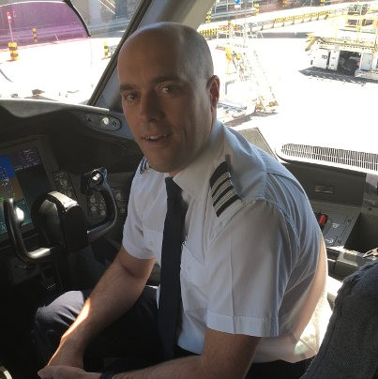



Tech Days 2021 Flight into IoT
Clifford Agius
IoT Solutions Expert / Airline Pilot
CA Software Ltd
Azure MVP
@cliffordagius

Slide 2









Flight into IoT System Diagram
Service Bus Queue
Logic
App
3rd Party Services
IoT Hub
Time Series Insights
Device Provisioning Service
Stream Analytics
Power BI

Slide 3
Demos
IoT Hub Creation and Device Simulation

Slide 4
Flight into IoT Useful Links
Azure IoT Hub Docs
https://docs.microsoft.com/en-us/azure/iot-hub
nanoFrameWork
https://www.nanoframework.net
Derive the device key
https://docs.microsoft.com/azure/iot-dps/how-to-legacy-device-symm-key
Cloud Skills Challenge
https://docs.microsoft.com/learn/challenges
GitHub Repo
https://github.com/CliffAgius/TechDays2021

Slide 5
Thankyou
Q&A
Clifford Agius
IoT Solutions Expert / Airline Pilot
CA Software Ltd
Azure MVP
@cliffordagius

